Slide 1
Personal Loans Case Red Ventures Interview
Michael San Pietro

Slide 2
Goals
Better understand lending firms
What variables do they consider?
Which are most influential?
Define subsections of the customer base to target
Do certain groups have better approval rates with certain lenders?
Improve Revenue per Application
Essentially maximizing the approval rate multiplied by the bounty

Slide 3
Core Variable relationship with Approvability
Core variables:
These Variables have been identified as Core Variables because they have large statistically significant effects that do not vary much in their magnitude or significance between lenders.
FICO Score
Has a universally positive and significant relationship with loan approval rates
Loan Amount
Has a universally negative and significant relationship with loan approval rates
*All calculations of statistical significance and coefficient direction completed using a logistic regression model
*Universal-it does not vary by lender

Slide 4
Other Variable Relationships with Approvability
Monthly Housing Payment
Significant negative correlation likely due to credit risk
Employment
The distinction between full and part-time has an effect, with full-time being favored (positive correlation); this effect remains significant even when holding Monthly Income constant
Ever having gone bankrupt or been foreclosed on
A significant negative correlation. It is interesting to note that this remains a strong determinant of approval rate even when holding FICO Score constant

Slide 5
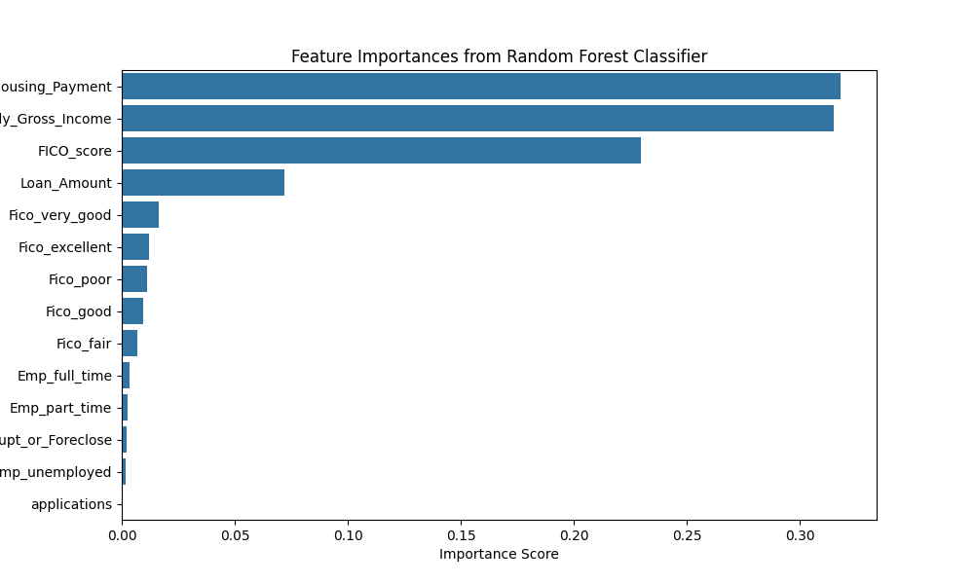
Determinants of Approvability Quantified
Random Forest Model
Machine Learning model that splits variables based on the prediction of a y variable (in this case probability of being approved for a loan)
Assigns each variable an importance score (think of this as how significant a role each variable plays when determining the probability of a loan approval)
The two most important variables in terms of significance are Monthly Housing Payment and Monthly Gross Income

Slide 6
Conclusions Regarding Variable Approvability
The Reason for the Loan and the Sector of Employment don’t seem to be significant determinants of approvability on aggregate; any effects observed are likely due to other observed factors (Monthly Income, FICO score, etc.), as their effects become insignificant when holding the other observed factors constant. However, they become important when observing differences between firms
Monthly Housing Payment and Monthly Gross Income are the most important determinants of the loan approval rate on aggregate
The variables of FICO Score and Loan Amount are “core variables” due to their consistently significant effects
Other factors (Employment type and ever having gone bankrupt or been foreclosed on) remain important determinants of approval rate

Slide 7
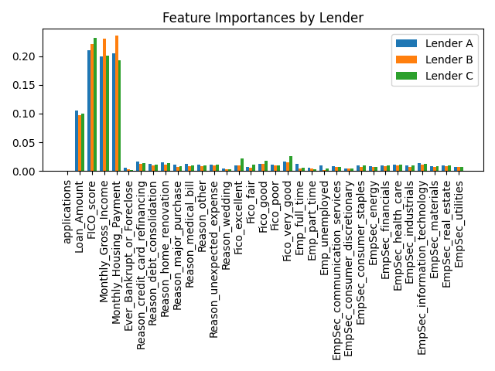
Differences between the Preferences of Lending Firms
Preferences and requirements of firms differ significantly
Lender A seems to be the most lenient
Approval rates and bounties have an Inverse Relationship
Approximate Approval Rates By Lender in decimal format:
Lender A | 0.17
Lender B | 0.11
Lender C | 0.07

Slide 8
Observable Differences Between Lending Firms
Firm A:
Most Important Factors: FICO score, Housing Payment, Gross Amount, Loan Amount, Reason: Credit Card Refinancing
Lenient Approval Rate
Lowest Average FICO Score Rate (625.501)
Ideal for applicants with suboptimal credit, especially those looking for Credit Card Refinancing
Firm B:
Most Important Factors: Monthly Housing Payment, Monthly Gross Income, FICO Score, Loan Amount
Has a high correlation with applicants in FICO’s “very good” range of scores.
Lowest Unemployment rate conditional on approval (0.018)
Ideal for applicants with steady employment and a “very good” FICO score
Firm C:
Most Important Factors: FICO score, Monthly Gross Income, Monthly Housing Payment, Loan Amount
Has a high correlation with applicants in FICO’s “very good” range of scores.
Lowest Approval Rate
High bounty with low approval rate, good sell to incredibly qualified applicants
*Most Important Factors-Factors with the highest feature importance for the random forest model run on each firm’s data

Slide 9
Incrementing Revenue Through Customer Filtering
Fundamental Problem: There exists a mismatch between customers and lenders when an applicant applies to a firm for a loan without being properly matched. Applicants could be applying to firms for which they are underqualified, in which case no bounty is collected, or they could be applying to firms in which they are overqualified, for example, an applicant applies to A when they could have received a loan from C, in which case there is a significant bounty reduction.
Solution: Create a statistical model that can accurately assign customers to the best firm based on the probability that they get the loan, weighted by the bounty on the loan.

Slide 10
The Solution
The large advantage here is the amount and quality of data collected, which lends itself well to statistical modeling using a logistic regression
Logistic Regression: A statistical model that uses data points to create a probability distribution curve, which can be used to predict outcomes
We cannot predict with perfect accuracy the approval rate of a singular customer, but we can predict, on average, the approval rate of customers like that customer. Given that we have 100,000 observations, this prediction can become incredibly accurate
How it works:
Train a model based on approval data from each lender: this outputs coefficients which can be used to predict any given customer’s acceptance rate for that lender
For each customer in the dataset, determine the most profitable lender. This is done using the following calculation, as bounties differ between lenders: The probability that a given customer is approved for a loan with a given firm multiplied by the bounty for that firm. This becomes an expected value, which we can back-test to determine the profitability of this strategy.

Slide 11
Outputs and Advantages for this Strategy
Back testing the model provided an increase of $922,610.1 in expected revenue, which represents a roughly 35% increase from the current amount of $2,642,200
Back testing strategy completed by subtracting the current bounty from the expected bounty using the group assignment from the regression
Advantages
Completely automated, customers can be fitted into lender groups in real time
More data, as customers use this model, the additional data can be used to better refine the model

Slide 12
Final Considerations
Look into the bounty system, if we find that more customers are being matched with specific lenders perhaps, we contact the other lenders and see if they are willing to provide larger incentives in exchange for more business
Implement a recommendation system for customers who were denied approval, recommending the next highest expected revenue lending firm

